Slide 1
Service Mesh and Istio

Slide 2
Objectives
After watching this video, you will be able to:
• List the benefits of microservices
• Describe the challenges that come with
microservices
• Explain what a service mesh is
• Describe why a service mesh is useful
• Describe the ways in which a service mesh can
alleviate common microservices challenges

Slide 3


Benefits of microservices
• Update code more easily
• Implement different
technology stacks for
different components
• Scale components
independently

Slide 4
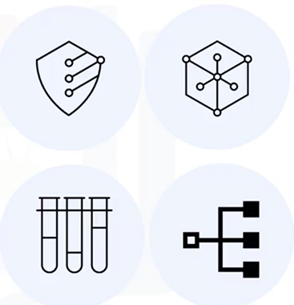
Challenges of microservices
Additional configuration
necessary to implement:
• Encrypted traffic among services
• Canary deployments and A/B testing
• Retries and circuit breaking to prevent cascading failures

Slide 5

What is a service mesh?
A dedicated layer that enables
fast, secure, and reliable service-
to-service communication
• Manages traffic
• Encrypts traffic between services
• Observes service behavior for
network optimization and
troubleshooting

Slide 6
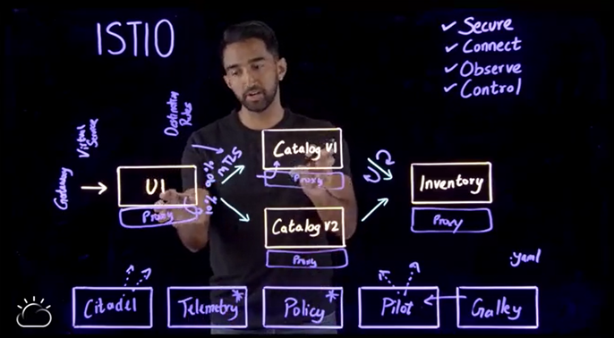
Istio service mesh

Slide 7
Summary
In this video, you learned that:
• Microservices architectures need security between
services as well as ways to manage and test
services
•A service mesh is a dedicated layer that provides
security and more by coordinating communication in
the envlronment
• Istio provides traffic shifting, mutual transport
layer security (TLS), and telemetry when deployed
with microservices

